Slide 1
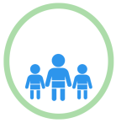
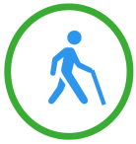
Title
What is strong?
Starting well
Living/ working well
Ageing well
Across the life course (applies to all ages)
What assets could be developed? What sort of things might work? How could the people in need be reach?
The examples below are illustrative. Your own suggestions will be based on the assets identified above:
Reduce stigma associated with food banks
Give projects longer to succeed; build connections and trust
Expand LAP across Kirklees in Libraries
Citizens Advice queues
Using key members in communities to pass on/share information
Developing Self Esteem in libraries
Libraries can be a source of information on what’s on offer locally
Good communications across services, organisations & groups
Enabling everyone to be able to spot issues in themselves and in others
Unused resources such as poly tunnel and raised beds
Support for families to eat better particularly in areas of deprivation
Would be useful to know what is under threat in the area → opportunity to amalgamate
Fear of joining clubs
Some need hand holding
Assets should: Provide opportunities for people to have a say, Build people’s skills and knowledge, Enable people to interact more with others, help build self resilience, be clear how people can access assets, communicate their offer to their target audience, be aware of barriers to access for people.

